Slide 1
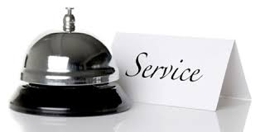
CUSTOMER SERVICE: Unit 3

Slide 2
UNIT OBJECTIVES
Unit 3 – The Psychology of Customer Flow
Customer Flow Management
Waiting Lines
Virtual Waiting
Technology

Slide 3
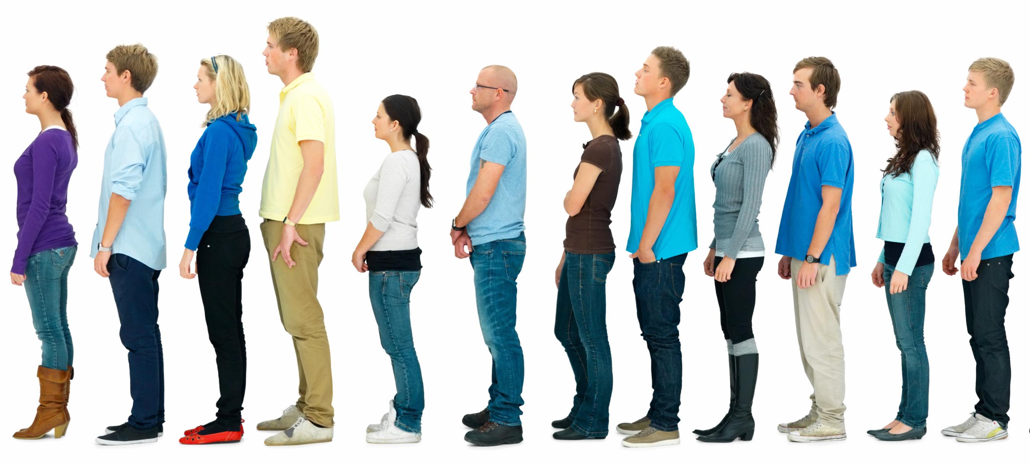
Where do we often join lines for service?

Slide 4
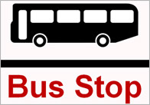
Queuing/waiting
A queue is a waiting line of "customers" requiring service from one or more servers. Queuing theory deals with problems that involve waiting (or queuing) or it is simply the study of the waiting line systems.
It is quite common that instances of queue occurs everyday in our daily life. Examples of queues or long waiting lines might be:
Waiting for service in bank and at reservation counter
Waiting for a train or bus
Waiting at barber salon
Waiting at doctors’ clinic
Highway toll booth

Slide 5
WHAT IS CUSTOMER FLOW/management?
Customer flow is the number and pattern of customers coming into or passing through a service organization.
Customer Flow Management (CFM) is a process which takes into account the entire customer experience, from the time they arrive at your site to the completion of their “transaction” to post-service analysis.

Slide 6
Importance of customer flow
It can increase sales, both in terms of immediate impulse buys and future customer loyalty, by producing happier customers.
It will increase staff productivity (thus decreasing your costs) by efficiently matching staff members to customers.
It provides management data about customers and business processes, which can lead to ongoing competitive advantages.

Slide 7
Why should we MANAGE CUSTOMER FLOW?
Whenever a customer arrives at a service facility, some of them usually have to wait before they receive the desired service.
This forms a queue or waiting line, make customer feel discomfort either mentally or physically because of long waiting queue. We infer that queues form because the service facilities are inadequate.

Slide 8
If service facilities are increased, then the question arise how much to increase?
For example, how many buses would be needed to avoid queues? How many reservation counters would be needed to reduce the queue?
Increase in number of buses and reservation counters requires additional resources. At the same time, cost due to customer dissatisfaction must also be considered.

Slide 9
ASSESSING CUSTOMER FLOW
The first step to implementing Customer Flow Management is to assess your current situation. Gather data on:
the number of customers at your site per hour or per day
your peak customer times
the average customer wait time
the average amount of time it takes to service a customer
all feedback (both positive and negative) from customers
any identifiable patterns regarding your staff’s productivity.

Slide 10
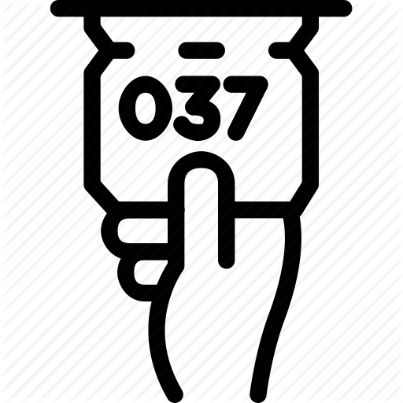
Managing customer flow
Determine an acceptable waiting time for your customers
Try to divert your customer’s attention when waiting
Inform your customers of what to expect
Keep employees not serving the customers out of sight
Segment customers
Train your servers to be friendly
Encourage customers to come during the slack periods
Take a long-term perspective toward getting rid of the queues

Slide 11
Application of customer flow management
Customer flow management has been applied to a great variety of business situations.
Customer flow management can be applied to determine the number of check out counters needed to secure smooth and economic operations at various time during the day at a supermarket or a departmental store .
Customer flow management can be used to analyze the delays at the toll booths of bridges and tunnels.
Customer flow management can be used to improve the customers service at restaurants, cafeteria, gasoline service station, airline counters, hospitals etc.
Customer flow management can be used to determine the number of personnel to be employed so that the cost of the production loss from down time and the cost of repair is minimized.

Slide 12
The customer flow management process
The Customer Flow Management process encompasses the entire customer experience, not just the time they spend waiting in line. These are the phases in the process:
Pre-arrival
In some applications, a CFM process can lead you to set up appointments prior to the customer’s arrival on site, which will decrease the customer’s waiting time. Advance customer knowledge will also enable you to provide more appropriate, personalized service, resulting in a more satisfied customer.

Slide 13
The customer flow management process
Customer Arrival On Site
There are a number of options which can lead you to achieve either faster, or more customer-focused flow management at this point. When possible, different lines can be designated for different customers. You might be able to match up the most appropriate staff member with a customer based on what you learn about that customer. You could have a special line or waiting area for VIP customers. This phase also becomes your first tracking point – here is where your measurement of the customer’s experience begins.

Slide 14
The customer flow management process
Service Point
After the customer’s wait in line is over, and they proceed to the next available staff member, this is another point at which critical data should be gathered. How long did their transaction take? Did they take advantage of point-of-purchase opportunities? CFM can also give management the opportunity for a macro view of all service points to determine open counters, agent efficiency, and other important data.

Slide 15
Post-Service
At this point, customers can provide feedback via surveys. Many customers appreciate the fact that their opinions are being heard, and this information can give you great insight into customers’ perception of your business. This is also the time for data crunching to make future improvements in areas where they are needed.

Slide 16
How Queues work
The customers arrive at service counter (single or in a group) and attended by one or more servers. A customer served leaves the system after getting the service.
In general, a queuing system comprise with two components, the queue and the service facility.

Slide 17
How Queues work
The queue is where the customers are waiting to be served. The service facility is customers being served and the individual service stations.
A queue forms whenever existing demand exceeds the existing capacity of the service facility; that is whenever arriving customers cannot receive immediate service due to busy servers.

Slide 18
LINEAR WAITING
Linear Waiting is most frequently used in retail applications. The most common type of linear waiting line is one in which there is a single line and a single cashier or service counter. This is usually the situation in small stores or fast food restaurants. Usually, only minimal line management products are needed in these settings – perhaps a few stanchions (with accompanying retractable belts or ropes) to visually denote the line space.

Slide 19
LINEAR WAITING
For busier locations, a more elaborate queuing system is the “Multiple Queue – Multiple Service Points” arrangement. This “first come, first serve” set up is frequently seen at airports and banks. Customers line up in the order in which they arrive, and they are called to the service desk by the next available agent.

Slide 20
LINEAR WAITING
Linear queuing is perceived as fair, and wait time is minimized, as one patron is ready to be served as soon as another is finished.
Note that the linear queuing option which has the most potential negative ramifications is the Multiple Queue – Multiple Service Points” option, which, with the exception of supermarkets and some fast food restaurants, is not favored by most locations.
The danger in this case is that customers are forced to choose a line and through no fault of their own, may be stuck in a slow moving line, which they will perceive as a very frustrating experience.

Slide 21
VIRTUAL WAITING
Virtual queuing means that the customer is identified upon arrival and placed in a ‘virtual queue'.
The virtual queue is invisible in the sense that the customers are not confined to any particular waiting spot and hence don't know what position they have in the queue relative to other individual customers.
This scenario requires customers to be either greeted and queued by a member of staff or entered into the queue through some type of technology, like a ticket-printer, a self-serve kiosk, etc.
Identification can be made via some customer unique attribute (name, social security number, etc.) or an assigned attribute chosen by the staff or the customer (typically a number or a letter combination).

Slide 22
VIRTUAL WAITING
Once the customers have been placed in a queue they can be engaged in active waiting with the guarantee that they will be served at the appropriate time. As in the case with linear queuing, virtual queuing has developed to become more sophisticated over time.
In the most common type of virtual queues, staff call the next customer when service to the current customer is finished.
In order to speed up the process, staff can pre-call the next customer before service to the current customer has actually finished. This could be done automatically, for example by connecting the cash register with the queuing system and have the next customer called immediately when the currently served customer starts paying.
It could also be done manually by providing the staff with a button to press when appropriate. In either case the effect is that a buffer zone with a waiting customer is created behind the currently served customer.

Slide 23
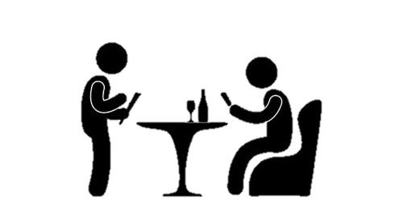
Queuing Systems
Key elements of queuing systems:
Customer: refers to anything that arrives at a facility and requires service, e.g., people, machines, trucks, emails
Server: refers to any resource that provides the requested service, e.g. repair persons or ATM machines

Slide 24
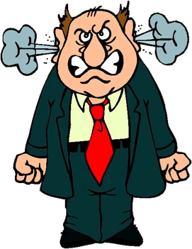
Characteristics of a customer flow system
In designing a good Customer flow management system, it is necessary to have provide customers with the following information about the model:
The arrival pattern
The service mechanism
The queue discipline
The number of service channels
Number of service stages

Slide 25
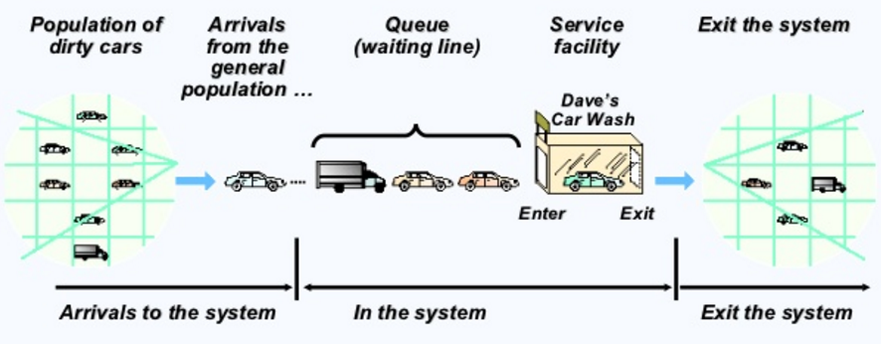
Parts of a Queue

Slide 26
Parts of a Queue
Population of Customers: can be considered either limited (closed systems) or unlimited (open systems). Unlimited population represents a theoretical model of systems with a large number of possible customers (a bank on a busy street, a motorway petrol station). Example of a limited population may be a number of processes to be run (served) by a computer or a certain number of machines to be repaired by a service man.
Arrival: defines the way customers enter the system. Mostly the arrivals are random with random intervals between two adjacent arrivals. Typically the arrival is described by a random distribution of intervals also called Arrival Pattern.
Output: represents the way customers leave the system. Output is mostly ignored by theoretical models, but sometimes the customers leaving the server enter the queue again

Slide 27
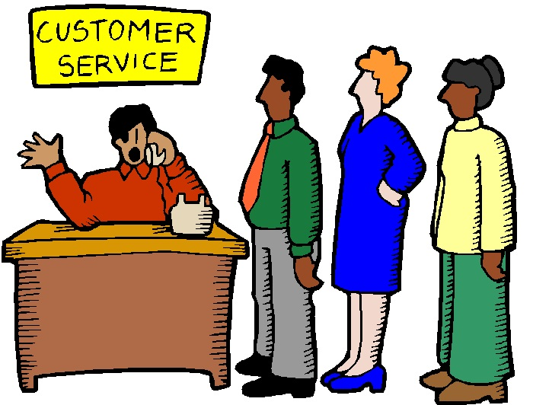
Queuing Models
The customers’ entry into the service system depends upon the queue conditions.
If at the time of customers’ arrival, the server is idle, then the customer is served immediately. Otherwise the customer is asked to join the queue, which can have several configurations.
By configuration of the service system we mean how the service facilities exist.
Service systems are usually classified in terms of their number of channels, or numbers of servers.

Slide 28
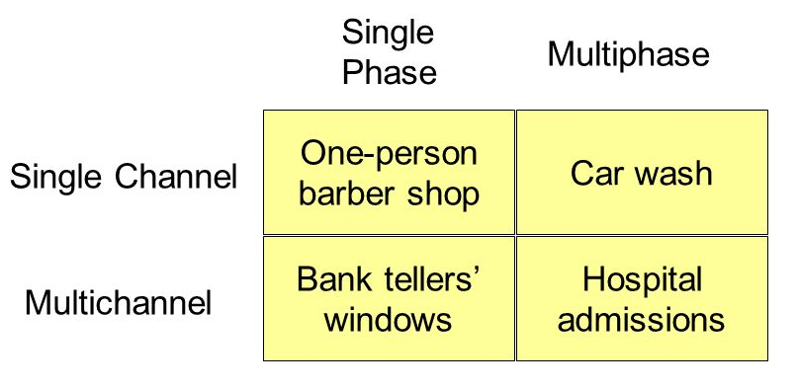
Queuing Models
Single Channel – Single Phase
Single Channel – Multi Phase
Multi Channel – Single Phase
Multi Channel – Multi Phase

Slide 29
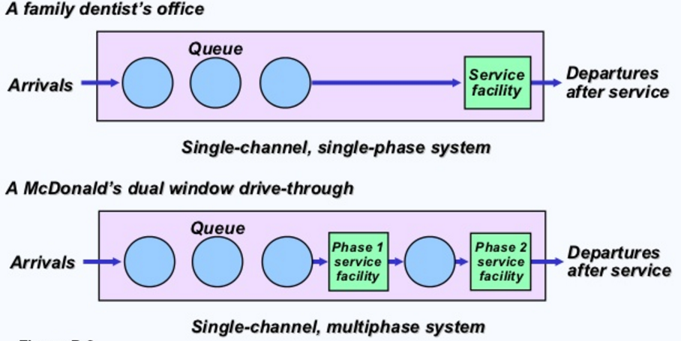
Queuing Models

Slide 30
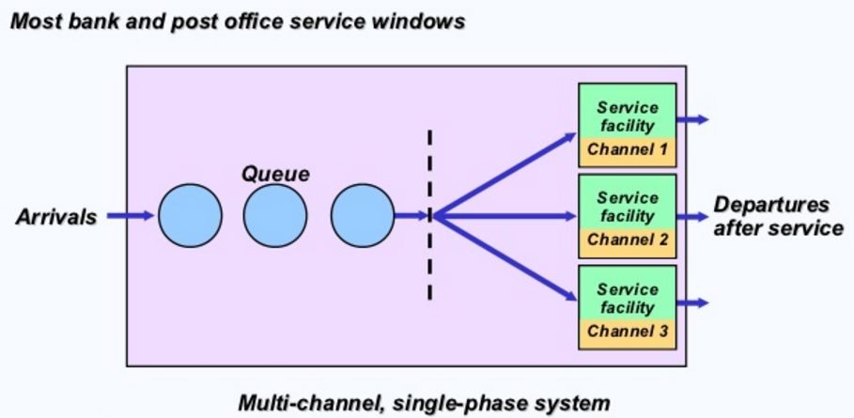
Queuing Models

Slide 31
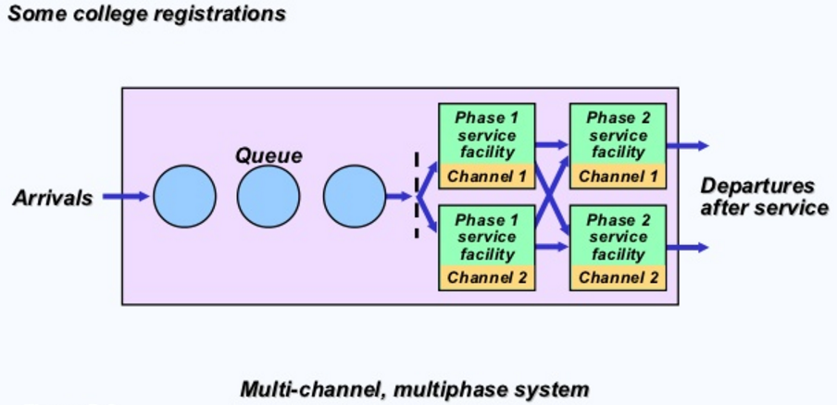
Queuing Models

Slide 32
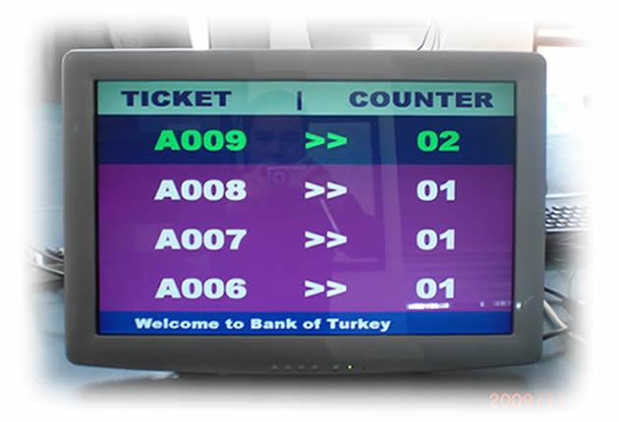
Technology and customer flow
Technology improves:
Efficiency
Speed
Convenience
Diversification of service
Customer satisfaction
Staff productivity
Optimisation of resources

Slide 33
Psychology & Perceptions of Queue
Occupied Time Feels Shorter Than Unoccupied Time
E.g. reading a magazine diverts the attention from the wait
Pre-process waits feel longer than in-process waits
E.g. you have your meal ticket in hand waiting for your order
Anxiety Makes Waits Seem Longer
E.g. Waiting for a critical medical diagnosis i.e. benign/malignant tumor
Uncertain Waits Are Longer than Known, Finite Waits
E.g. Sending a package via regular mail overseas versus a set time for express service of 3-5 days
Physically uncomfortable waits feel longer
E.g. Standing in line under sunlight vs. sitting in an air conditioned lounge

Slide 34
Psychology & Perceptions of Queue
Unexplained Waits Are Longer than Explained Waits
E.g. A service is taking longer than usual without an excuse i.e. repairing a piece of equipment
Unfair Waits Are Longer than Equitable Waits
E.g. If another customer cuts the line it is aggravating
The More Valuable the Service, the Longer the Customer Will Wait
E.g. Waiting to get into a star-studded concert is an experience in itself
Solo Waits Feel Longer than Group Waits
E.g. People feel more comfortable when they share their frustration
Waits seem longer to new or occasional users
E.g. The service process cannot be rationalised due to unfamiliarity

Slide 35
PRACTICE QUESTION
Define Customer Flow. (2 mark)
Discuss the advantages and disadvantages of linear waiting and virtual waiting. (5 marks)
List the four (4) queuing models and discuss the configuration of two (2) models. (8 marks)
Explain how you would make waiting easier and more pleasant at your service organisation by explaining five (5) perceptions and psychology of people in waiting. (15 marks)
(Total 30 Marks)

Slide 36
Advanced Reading: Unit 4
Unit 4 – Communication and Customer Service

Slide 37
References
People in line from http://furthertheconversation.com/wp-content/uploads/2014/08/waiting-in-line.jpg
Queueing models chart from https://www.isixsigma.com/industries/retail/queuing-theory-and-practice-source-competitive-advantage/ and http://images.slideplayer.com/26/8821494/slides/slide_5.jpg
Queueing Theory from http://www.slideshare.net/benghuid/queueing-theory-7085316 and http://www.slideshare.net/amitcyrus/queuing-theory and http://www.slideshare.net/avtarsingh/queuing-theory-2129896
Parts of a Queue from http://www.slideshare.net/RIZWANKHURRAM/heizer-mod-d
Clocks from http://blog.innotas.com/wp-content/uploads/2014/06/Time-Tracking.png
Psychology of waits from http://www.slideshare.net/28Sneha/8managing-demand-and-capacity-and-waiting-line-strategies
Customer flow notes from http://www.queuelines.com/queuing-blog/customer-flow-management-the-importance-of-managing-customer-lines-and-wait-times-at-your-location/

